Slide 1


Customer Feedback
Contoso Electronics
Keeping the Ball Rolling

Slide 2

Goal Flowchart
Primary Goal: With the success of our latest line, we are pushing forward to create a series of ads that will invoke and maintain an emotional connection.
Six Months to One Year of Use
Return for New Model
Customers Purchase

Slide 3
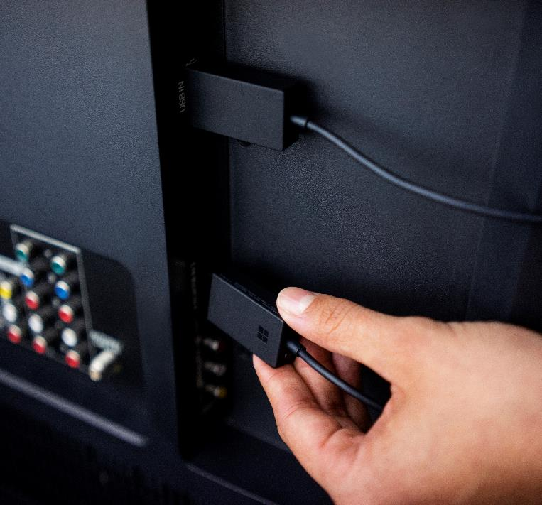
Creating a Connection
Inspiring brand loyalty starts with encouraging buyers to return for new lines
How do we connect with the consumer?

Slide 4

Brainstorm Session
Discuss branding options for the fall preview
What are reasonable expectations for customer return rate?

Slide 5
FY January to July Goals
Jan-Feb
Continue Ad Campaign for the New Line
Vary the Media to Increase Interest
March-April
Announce New Products
Make Sure Campaign is Distinct from Previous
May-July
Retain Brand Theme: “The Smile”
On Release, Stress New Features and Promote Recycling Old Products

